Slide 1
Application Layer

Slide 2


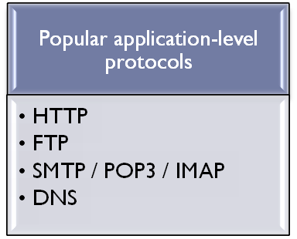

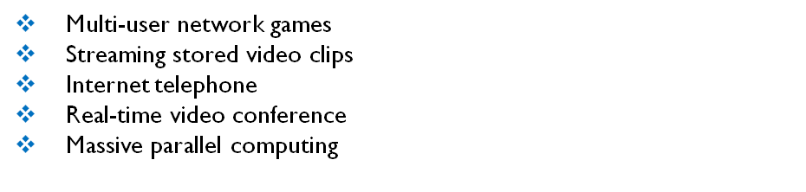


Goal and A sample Network App
Write programs that
  run on different end systems and
  communicate over a network.
  e.g., Web: Web server software communicates with browser software
Little software written for devices in network core
  network core devices do not run user application code
  application on end systems allows for rapid app development, propagation
  Some Network Apps
E-mail
Web
Instant messaging
Remote login
P2P file sharing
application
transport
network
data link
physical
application
transport
network
data link
physical
application
transport
network
data link
physical

Slide 3
Application architectures
Client-server
Peer-to-peer (P2P)
Hybrid of client-server and P2P
Note: App. Architecture is totally different from network architecture (OSI or TCP/IP model)

Slide 4
Client-server architecture
Server:
  always-ON host
  permanent IP address
  server farms for scaling
Clients:
  communicate with server
  may be intermittently connected
  may have dynamic IP addresses
  do not communicate directly with each other

Slide 5
Pure P2P architecture
No always-on server
Arbitrary end systems directly communicate
Peers are intermittently connected and change IP addresses
Self capability
Example: gnutella
Highly scalable but difficult to manage

Slide 6
Hybrid of client-server and P2P
Skype
  Internet telephony app
  Finding address of remote party: centralized server(s)
  Client-client connection is direct (not through server)
Instant messaging
  Chatting between two users is P2P
  Presence detection/location centralized:
    User registers its IP address with central server when it comes online
    User contacts central server to find IP addresses of buddies

Slide 7
Processes communicating
Process: program running within a host.
Within same host, two processes communicate using inter-process communication (defined by OS).
Processes in different hosts communicate by exchanging messages
Client process: process that initiates communication
Server process: process that waits to be contacted
Note: applications with P2P architectures have client processes & server processes

Slide 8
Sockets
Process sends/receives messages to/from its socket
Analogous to door
host or
server
host or
server
controlled by
app developer
process
process
socket
socket
TCP with
buffers,
variables
TCP with
buffers,
variables
Internet
API (application Programming Interface):
choice of transport protocol;
ability to fix a few parameters.
controlled
by OS

Slide 9
Addressing processes
to receive messages, process must have identifier
host device has unique32-bit IP address
Q: does IP address of host on which process runs suffice for identifying the process?

Slide 10
Addressing processes
to receive messages, process must have identifier
host device has unique32-bit IP address
Q: does IP address of host on which process runs suffice for identifying the process?
  Answer: NO, many processes can be running on same host
identifier includes both IP address and port numbers associated with process on host.
Example port numbers:
  HTTP server: 80
  Mail server: 25
to send HTTP message to jiit web server:
  IP address: 172.16.120.10
  Port number: 80

Slide 11
App-layer protocol defines
Types of messages exchanged,
  e.g., request, response
Message syntax:
  what fields in messages & how fields are delineated
Message semantics
  meaning of information in fields
Rules for when and how processes send & respond to messages
Public-domain protocols:
defined in RFCs
allows for interoperability
e.g., HTTP, SMTP
Proprietary protocols:
e.g., KaZaA

Slide 12
What transport service does an app need?
Reliable Data Transfer
some apps (e.g., audio) can tolerate some loss
other apps (e.g., file transfer, telnet) require 100% reliable data transfer
Bandwidth/Throughput
some apps (e.g., multimedia) require minimum amount of bandwidth to be “effective”
other apps (“elastic apps”) make use of whatever bandwidth they get
Security
Timing
some apps (e.g., Internet telephony, interactive games) require low delay to be “effective”

Slide 13
Transport service requirements of common apps
Application
file transfer
e-mail
Web documents
real-time audio/video
stored audio/video
interactive games
instant messaging
Data loss
no loss
no loss
no loss
loss-tolerant
loss-tolerant
loss-tolerant
no loss
Bandwidth
elastic
elastic
elastic
audio: 5kbps-1Mbps
video:10kbps-5Mbps
same as above
few kbps up
elastic
Time Sensitive
no
no
no
yes, 100’s msec
yes, few secs
yes, 100’s msec
yes and no

Slide 14
Internet transport protocols services
TCP service:
connection-oriented: setup required between client and server processes
reliable transport between sending and receiving process
flow control: sender won’t overwhelm receiver
congestion control: throttle sender when network overloaded
does not provide: timing, minimum bandwidth guarantees
UDP service:
unreliable data transfer between sending and receiving process
does not provide: connection setup, reliability, flow control, congestion control, timing, or bandwidth guarantee
Q: why bother? Why is there a UDP?

Slide 15
Internet apps: application, transport protocols
Application
layer protocol
SMTP [RFC 2821]
Telnet [RFC 854]
HTTP [RFC 2616]
FTP [RFC 959]
proprietary
(e.g. RealNetworks)
proprietary
(e.g., Vonage,Dialpad)
Underlying
transport protocol
TCP
TCP
TCP
TCP
TCP or UDP
typically UDP
Application
e-mail
remote terminal access
Web
file transfer
streaming multimedia
Internet telephony

Slide 16
Web and HTTP
A Web page consists of objects
  An Object can be a HTML file, JPEG image, Java applet, audio file,…
Most Web pages consist of a base HTML-file and several referenced objects
The base HTML file references the other objects in the page with the object’s URL
  a URL has 2 components: the host name of the server that houses the object and the object’s path name
www.someschool.edu/someDept/pic.gif
host name
path name

Slide 17
HTTP overview: hypertext transfer protocol
HTTP
Web’s application layer protocol
client/server model
  client: browser that requests, receives, “displays” Web objects
  server: Web server sends objects in response to requests
HTTP 1.0: RFC 1945
HTTP 1.1: RFC 2068
HTTP request
PC running
Explorer
HTTP response
HTTP request
Server
running
Apache Web
server
HTTP response
Mac running
Navigator

Slide 18
HTTP overview (continued)
Uses TCP:
client initiates TCP connection (creates socket) to server, port 80
server accepts TCP connection from client
HTTP messages (application-layer protocol messages) exchanged between browser (HTTP client) and Web server (HTTP server)
TCP connection closed
HTTP is “stateless”
server maintains no information about past requests
aside
Protocols that maintain “state” are complex!
past history (state) must be maintained
if server/client crashes, their views of “state” may be inconsistent, must be reconciled
Notes:
a stateless protocol is a communications protocol in which no information is retained by either sender or receiver. The sender transmits a packet to the receiver and does not expect an acknowledgment of receipt. A stateless protocol does not require the server to retain session information or status about each communications partner for the duration of multiple requests.

Slide 19
HTTP connections
Nonpersistent HTTP
At most one object is sent over a TCP connection.
HTTP/1.0 uses nonpersistent HTTP
Persistent HTTP
Multiple objects can be sent over single TCP connection between client and server.
HTTP/1.1 uses persistent connections in default mode

Slide 20
Nonpersistent HTTP
Suppose user enters URL www.someSchool.edu/someDepartment/home.index
(contains text, references to 10 jpeg images)
1a. HTTP client initiates TCP connection to HTTP server (process) at www.someSchool.edu on port 80
1b. HTTP server at host www.someSchool.edu waiting for TCP connection at port 80. “accepts” connection, notifying client
2. HTTP client sends HTTP request message (containing path name) into TCP connection socket. Message indicates that client wants object someDepartment/home.index
time
3. HTTP server receives request message, forms response message containing requested object, and sends message into its socket

Slide 21
Nonpersistent HTTP (cont.)
4. HTTP server process tells TCP to close the TCP connection (but TCP terminates after assuring that data is received by client successfully).
5. HTTP client receives response message containing html file, displays html. Parsing html file, finds 10 referenced jpeg objects
time
6. Steps 1-4 repeated for each of the 10 jpeg objects
For 11 objects total 11 TCP connections will be opened.
Parallel connections or not? Depends on browser (open 5 to 10 parallel connections)

Slide 22
Non-Persistent HTTP: Response time
Definition of RTT: time to send a small packet to travel from client to server and back.
Response time:
one RTT to initiate TCP connection
one RTT for HTTP request and first few bytes of HTTP response to return
file transmission time
Total = 2RTT+transmission time
RTT includes T_{p}, T_{q}, T_{pg}
initiate TCP
connection
RTT
request
file
RTT
time to
transmit
file
file
received
time
time

Slide 23
Persistent HTTP
Nonpersistent HTTP issues:
requires 2 RTTs per object
OS overhead for each TCP connection (TCP buffers and variables)
browsers often open parallel TCP connections to fetch referenced objects
Persistent HTTP
server leaves connection open after sending response
subsequent HTTP messages between same client/server sent over open connection
Persistent without pipelining:
client issues new request only when previous response has been received
one RTT for each referenced object
Persistent with pipelining:
default in HTTP/1.1
client sends requests as soon as it encounters a referenced object
as little as one RTT for all the referenced objects

Slide 24
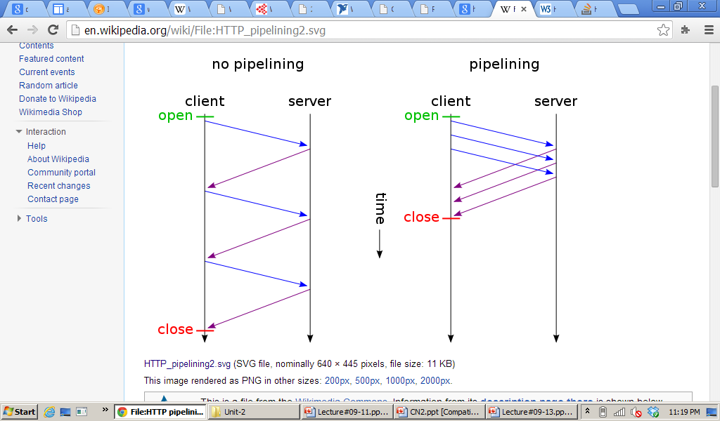

Slide 25
Practice:HTTP
Assume that you have base HTML file with 30 embedded images, images & base file are small enough to fit in one TCP segment. How many RTT are required to retrieve base file & images under-following condition :
(i) Non-Persistent connection without parallel connection
(ii) Non-persistent connection with 10 parallel connection
(iii) Persistent connection without pipelining
(iv) Persistent connection with pipelining
(Assume RTT dominates all other time)

Slide 26
Answers
62RTT
8RTT
32RTT
3RTT

Slide 27
HTTP request message
2 types of HTTP messages: request, response
HTTP request message:
  ASCII (human-readable format)
request line
(GET, POST,
HEAD commands)
GET /somedir/page.html HTTP/1.1
Host: www.someschool.edu
Connection: close
User-agent: Mozilla/4.0
Accept-language:fr
(extra carriage return, line feed)
Client doesn’t want
persistent conn.
header
lines
Different Objects for
diff. agents
Carriage return,
line feed
indicates end
of message
User prefers to
receive a French ver.
Of object

Slide 28

HTTP request message: general format
line feed
carriage return

Slide 29
Uploading form input
Post method:
Web page often includes form input
Input is uploaded to server in entity body
URL method:
Uses GET method
Input is uploaded in URL field of request line:
www.somesite.com/animalsearch?monkeys&banana

Slide 30
Method types
HTTP/1.1
GET, POST, HEAD
PUT
  uploads an object in entity body to the path specified in URL field (on a Web Server)
DELETE
  deletes an object specified in the URL field (from Web Server)
HTTP/1.0
GET
POST
HEAD
  asks server to leave requested object out of response (only header and status of requested object is sent) OR it is used for obtaining meta-information about the entity implied by the request without transferring the entity-body itself.

Slide 31
HTTP response message
status line
(protocol
status code
status phrase)
HTTP/1.1 200 OK
Connection close
Date: Thu, 06 Aug 1998 12:00:15 GMT
Server: Apache/1.3.0 (Unix)
Last-Modified: Mon, 22 Jun 1998 …...
Content-Length: 6821
Content-Type: text/html
data data data data data ...
Server going to close the conn.
header
lines
data, e.g.,
requested
HTML file

Slide 32
HTTP response status codes
In first line in server->client response message.
A few sample codes:
200 OK
  request succeeded, requested object later in this message
301 Moved Permanently
  requested object moved, new location specified later in this message (Location:)
400 Bad Request
  request message not understood by server
404 Not Found
  requested document not found on this server
505 HTTP Version Not Supported

Slide 33
User-server state: cookies
Many major Web sites use cookies
Four components:
  1) cookie header line of HTTP response message
  2) cookie header line in HTTP request message
  3) cookie file kept on user’s host, managed by user’s browser
  4) back-end database at Web site
Example:
  Kartik access Internet always from same PC
  He visits a specific e-commerce site for first time
  When initial HTTP requests arrives at site, site creates a unique ID and creates an entry in backend database for ID

Slide 34
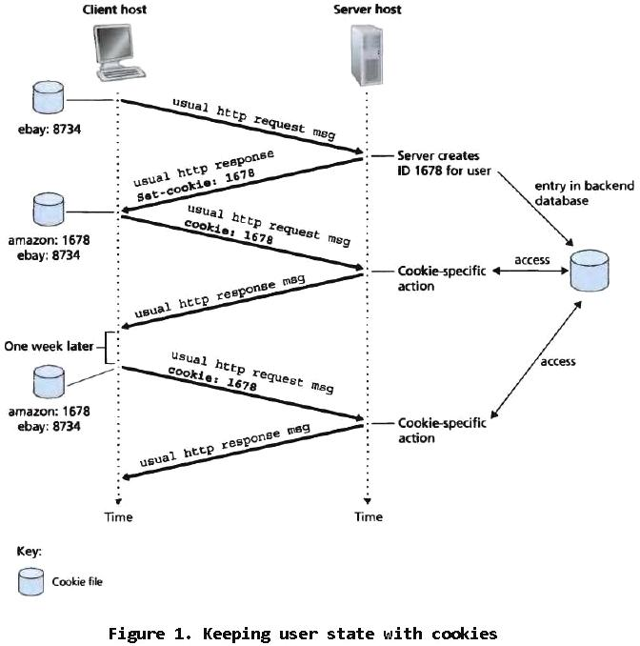

Slide 35
Cookies (continued)
aside
What cookies can bring:
authorization
shopping carts
recommendations
user session state (Web e-mail)
Cookies and privacy:
cookies permit sites to learn a lot about you
you may supply name and e-mail to sites
How to keep “state”:
Protocol endpoints: maintain state at sender/receiver over multiple transactions
cookies: http messages carry state

Slide 36
Web caches (proxy server)
Goal: satisfy client request without involving origin server
A caching server will store the updates locally the first time they’re requested by a client.
  The next time a client requests for the same updates, they are served locally, without having to go onto the internet
Browser sends all HTTP requests to cache
origin
server
Proxy
server
HTTP request
HTTP request
client
HTTP response
HTTP response
HTTP request
HTTP response
client
origin
server

Slide 37
More about Web caching
A cache server is often used in offices where a large number of computers continuously request for the same kind of data
  like software updates or database updates.
Cache acts as both client and server
Typically cache is installed by ISP (university, company, residential ISP)
Why Web caching?
Reduce response time for client request.
Reduce traffic on an institution’s access link.
Internet dense with caches: enables “poor” content providers to effectively deliver content

Slide 38
Caching example
origin
servers
Assumptions
average object size = 1 Mbits
avg. request rate from institution’s browsers to origin servers = 15/sec
delay from access link router to any origin server and back to router = 2 sec
Consequences
utilization on LAN = 15%
utilization on access link = 100%
total delay = Internet delay + access delay + LAN delay
public
Internet
15 Mbps
access link
institutional
network
100 Mbps LAN

Slide 39
Caching example (cont)
origin
servers
Possible solution
increase bandwidth of access link to, say, 100 Mbps
Consequences
utilization on LAN = 15%
utilization on access link = 15%
Total delay = Internet delay + access delay + LAN delay
= 2 sec + msecs + msecs
often a costly upgrade
public
Internet
100 Mbps
access link
institutional
network
100 Mbps LAN

Slide 40
Caching example (cont)
origin
servers
Install cache
suppose hit rate is .4
Consequence
40% requests will be satisfied almost immediately
60% requests satisfied by origin server
utilization of access link reduced to 60%, resulting in negligible delays (say 10 msec)
total avg delay = Internet delay + access delay + LAN delay = .6*(2.01) secs + .4*milliseconds = 1.21 secs
public
Internet
15 Mbps
access link
institutional
network
100 Mbps LAN
institutional
cache

Slide 41
Conditional GET
cache
server
Goal: don’t send object if cache has up-to-date cached version
cache: specify date of cached copy in HTTP request
  If-modified-since: <date>
server: response contains no object if cached copy is up-to-date:
  HTTP/1.0 304 Not Modified
HTTP request msg
If-modified-since: <date>
object
not
modified
HTTP response
HTTP/1.0
304 Not Modified
HTTP request msg
If-modified-since: <date>
object
modified
HTTP response
HTTP/1.0 200 OK
<data>

